Slide 1

BC2410, Prescriptive Analytics From Data to Decisions
Lecture 5

Slide 2
On Group Project
Case study of an optimization problem
Report – At most 10 pages
Introduction
Model formulation
Analysis of solutions
Code in Jupyter Notebook
Model should be generic
Data must be read from a file or directly import from an online database
Presentation (Week 13)
Due for report submission: 17 April (Week 13)
Notes:
PLEASE DO NOT COPY!
Please do not submit a lengthy report. 10 pages for the main content.
Presentation accounts for 10 marks. Each of you need to present.

Slide 3
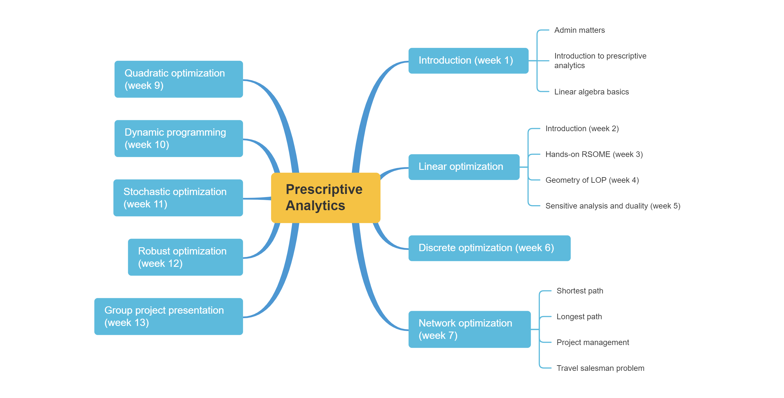
Schedule

Slide 4
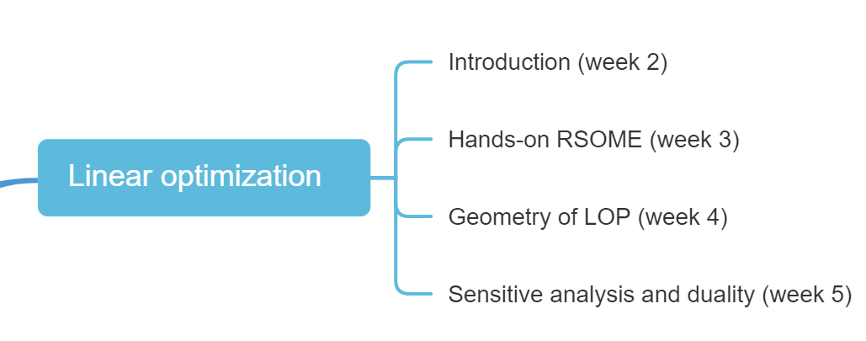
Schedule

Slide 5
Sensitivity analysis
In real applications, you may not be very certain about the data used
Sensitivity Analysis studies the effect of parameter changes
How does the optimal solution change with respect to changes in b_{i} and c_{j}?
How does the optimal objective value change with respect to changes in b_{i} and c_{j}?

Slide 6
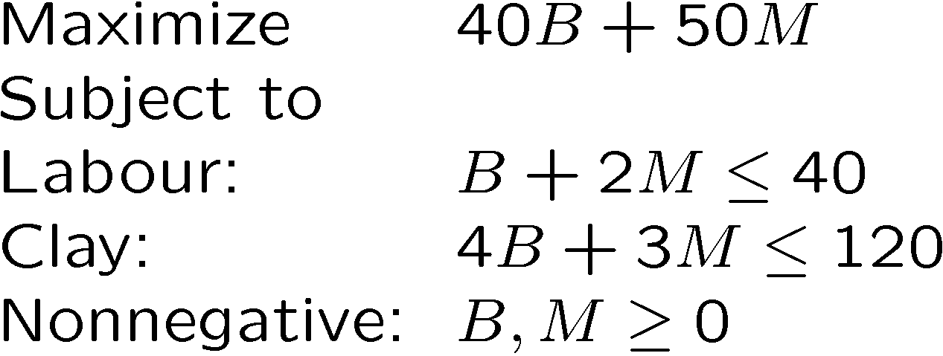
Example: A pottery company
Products: Bowls ($40) and Mugs ($50)
 | Bowl (B) | Mug (M) | Capacity
Labour | 1 | 2 | 40
Clay | 4 | 3 | 120
c₁
c₂
a₁₁
a₁₂
b₁
a₂₁
a₂₂
b₂

Slide 7
Changes in Objective Function Coefficients (c_{j})
Suppose c₁ changes, how would the optimal solution change?
M
40
max 40B + 50M
20
16
(24, 8)
0
20
30
40
B

Slide 8
Changes in Objective Function Coefficients (c_{j})
Say c₁ increases to 50?
M
40
max 50B + 50M
20
(24, 8)
0
20
30
40
B

Slide 9
Changes in Objective Function Coefficients (c_{j})
How about c₁ increases to 67?
What if c₁ is larger than 67?
M
40
max 67B + 50M
27
20
(24, 8)
0
20
30
40
B

Slide 10
Changes in Objective Function Coefficients (c_{j})
What if c₁ decreases?
What if c₁ is less than 25?
M
40
max 25B + 50M
20
10
(24, 8)
0
20
30
40
B

Slide 11
Changes in Objective Function Coefficients (c_{j})
As long as c₁ is in the range [25, 67], the optimal solution will NOT change
The sensitive range of an objective coefficient is the range of values over which the current optimal solution will remain optimal
How would the objective value change?
M
max c₁*B + 50M
25 ≤ c₁ ≤ 67
20
10
(24, 8)
0
20
30
40
B

Slide 12
Changes in Constraint Quantity (b_{i})
Suppose b₂ changes, how would the optimal solution change?
M
40
b₂ = 120
max 40B + 50M
20
(24, 8)
0
20
30
40
B

Slide 13
Changes in Constraint Quantity (b_{i})
Say b₂ decreases to 100
M
40
max 40B + 50M
b₂ = 100
20
(16, 12)
(24, 8)
0
20
30
40
B

Slide 14
Changes in Constraint Quantity (b_{i})
How about b₂ decreases to 60?
What if b₂ is below 60?
M
40
max 40B + 50M
(0, 20)
20
b₂ = 60
(24, 8)
0
20
30
40
B

Slide 15
Changes in Constraint Quantity (b_{i})
What if b₂ increases?
M
40
b₂ = 160
max 40B + 50M
20
(24, 8)
(40, 0)
0
20
30
40
B

Slide 16
Changes in Constraint Quantity (b_{i})
The optimal solution always changes if the corresponding constraint is binding
As long as b₂ is in the range [60, 160], the binding constraints will NOT change
The sensitivity range of a constraint quantity: the range of values over which the binding constraints will remain so
M
max 40B + 50M
60 ≤ b₂ ≤ 160
(0, 20)
20
(24, 8)
(40, 0)
0
20
30
40
B

Slide 17
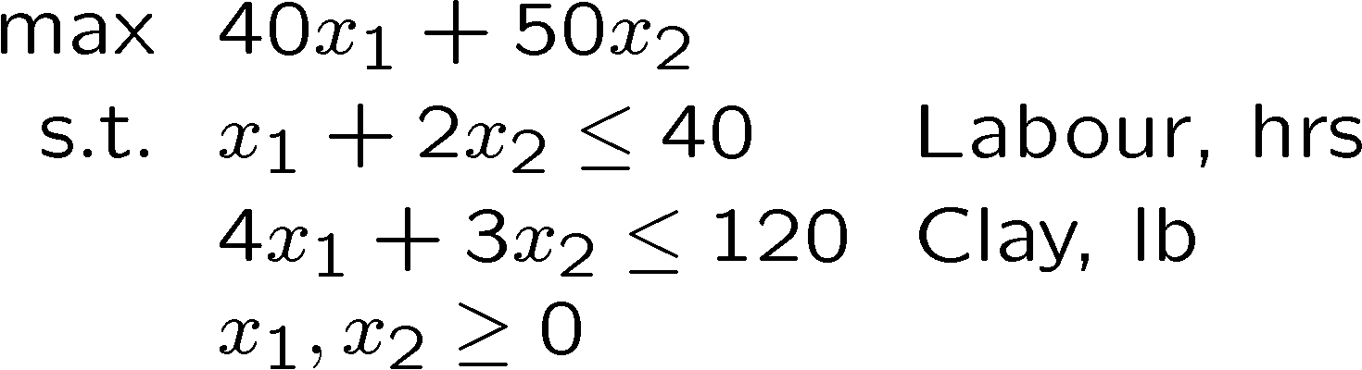
Excel Sensitivity Analysis Report
Notes:
Optimal solution will not change for
B in [40 – 15, 40 + 26.666666]
M in [50 – 20, 50 + 30]
At optimal solution, labour constraint remains binding when b1 in [40-10, 40 + 40]
Clay constraint remains binding when b2 in [120 – 60, 120 + 40]

Slide 18
Sensitivity Analysis
Shadow Price (or dual values): the marginal value of additional unit of resource.
Note that the shadow price is only valid in the sensitivity range.
Reduced cost: the marginal value in objective if we are forced to increase a zero variable
Notes:
The definition of shadow price is very important!!!
Suppose we have the following two problems:
Z1 = max 40B + 50M
s.t. B + 2M <= 40
4B + 3M <= 120
B,M >= 0
Z2 = max 40B + 50M
s.t. B + 2M <= 41
4B + 3M <= 120
B,M >= 0
Then p1 = 16 = Z2 – Z1.

Slide 19
Excel Sensitivity Analysis Report
What happened if you increase clay by 10 units?
Is it within the sensitivity range?
If yes, use shadow price. Otherwise, resolve.
Notes:
If we increase clay by 10 units, it is still within the sensitivity range. As such, our objective value will increase by 10*6 = 60

Slide 20
On Shadow Price
How would objective value change when c₁ increases by 1 unit, assuming the optimal solution remains unchanged?
How to compute shadow price?
How would objective value change when b₁ increases by 1 unit?
To compute shadow price, we need to solve an optimization problem call the dual problem.

Slide 21
Economic Interpretation
Primal
Dual
Manager optimizes revenue in primal problem.
Manager could sell his LABOUR and CLAY to a Buyer.
Dual Constraints:
Prices for LABOUR and CLAY that Manager would be stupid to refuse.
Rewards from selling each item, should be less than revenue received from selling the components to assemble the item.
Dual Objective:
Lowest cost to the Buyer.
Strong Duality:
Manager’s best revenue is the same Buyer’s lowest costs.
Notes:
The dual problem is
Min 40p1 + 120p2
s.t. p1 + 4p2 >= 40 (LHS: the amount we received for the resource of making a bowl. RHS: our profit of selling one bowl)
2p1 + 3p2 >= 50 (LHS: the amount we received for the resource of making a mug. RHS: our profit of selling one mug)
p1,p2 >= 0
Suppose we are facing another optimization problem,
Z1 = max 40B + 50M
s.t. B + 2M >= 40 : p1
4B + 3M <= 120 : p2
B,M >= 0
For the first constraint, we can interpret 40 as the demand that we need to satisfy. Then p1 will be the price that somebody else wants to help me satisfy the demand, in this case, we need to pay him/her, right? So p1 should be <= 0

Slide 22
Primal and Dual Problems

Slide 23
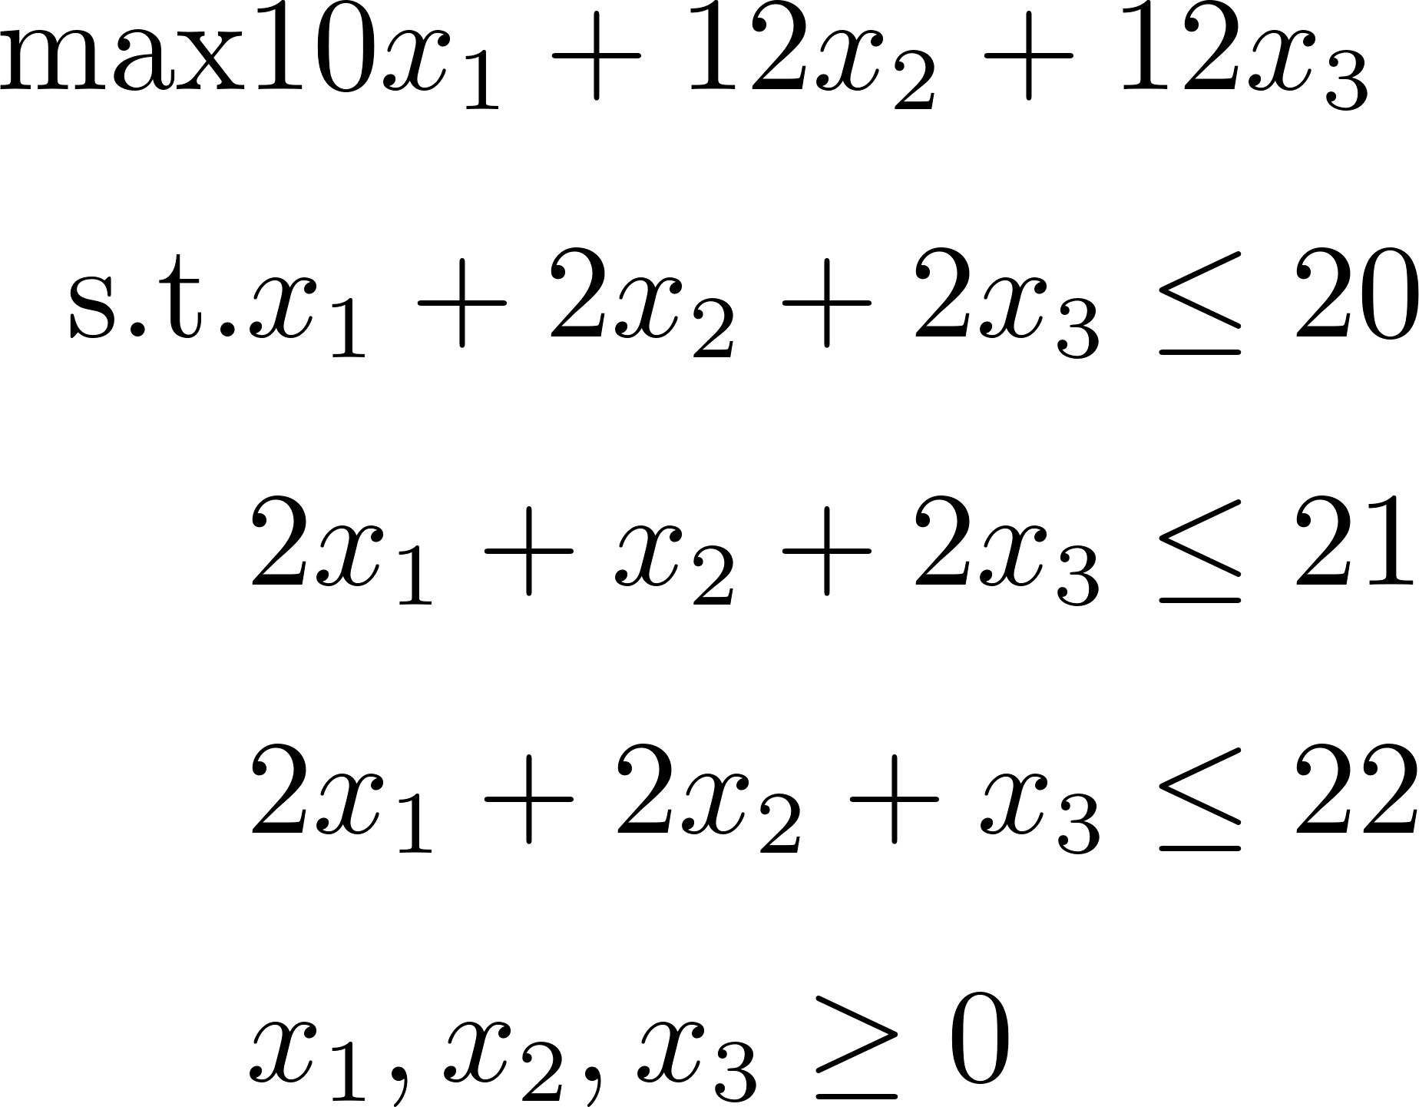
Primal and Dual Problem
Notes:
Here you just replace the alphabets with numbers in previous slides.
But I would recommend you to derive the dual from an economic perspective.

Slide 24
Matrix View (Optional)

Slide 25

Weak Duality

Slide 26
Weak Duality

Slide 27
Weak Duality (Optional)
Proof

Slide 28
Strong Duality

Slide 29
Strong Duality

Slide 30
Complementary Slackness
The optimal solutions of the Primal and Dual has the following complementary slackness conditions:
If a Primal constraint is not binding (i.e. slack > 0), then the corresponding Dual variable must be zero.
If a Primal variable is strictly greater than zero, then the corresponding Dual constraint must be binding.
If a Dual constraint is not binding (i.e. slack > 0), then the corresponding Primal variable must be zero.
If a Dual variable is strictly greater than zero, then the corresponding Primal constraint must be binding.
Notes:
Complementary slackness is only applied for optimal solutions of both the primal problem and dual problem.

Slide 31
Implication of Strong Duality
How to compute shadow price?
How would objective value change when b₁ increases by 1 unit, assuming the dual problem remains optimal?
What is the Shadow Price of a constraint that is not binding?
Implications of Complementary Slackness.
Notes:
Basically, if at the optimal solution, a constraint is non-binding/inactive, it indicates that this resource is not critical.
So for the dual variable, it must be 0.

Slide 32
Primal/Dual Generalization
The Primal/Dual problems pairs are interchangeable, i.e., Dual of the Dual is the Primal.

Slide 33
Primal with Equality
Dual variables associated with primal equality constraints are unconstrained or free.
Notes:
Think about the toy example
Max x1 + x2
s.t. x1 + 2x2 <= 3
2x1 + x2 <= 3
x1, x2 >= 0
If we change the first constraint to be x1 + 2x2 = 3
The feasible region will be a line segement.
Now if we increase 3 to 4, you cannot say anything about the objective value. That is, we cannot price the resource, so the corresponding shadow price will be free (can be positive, negative, or 0).

Slide 34
Dual with Equality
Primal variable associated with dual equality constraints are unconstrained or free.

Slide 35
Primal Inequality Change

Slide 36
Dual Inequality Change
Notes:
In summary, two steps to obtain the sign of dual variables:
Increase the RHS by one unit to see whether the feasible region is larger or smaller
A larger feasible region implies better solution: higher objective value for maximization problem, so p >= 0; lower objective value for minimization problem, so p <= 0
A smaller feasible region implies worse solution: lower objective value for maximization problem, so p <= 0; higher objective value for minimization problem, so p >= 0
Deciding the sign for constraints in the dual problem follows a similar logic.

Slide 37
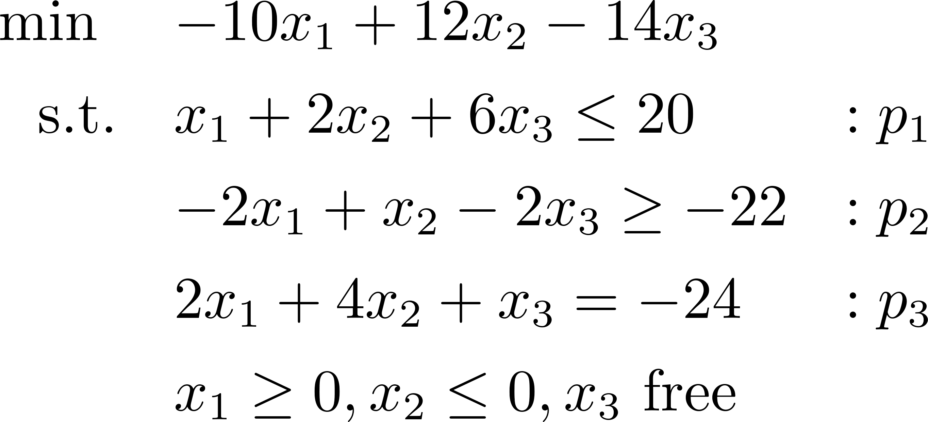
Primal and Dual Problem
Notes:
max 20 p1 – 22 p2 – 24 p3
s.t. p1 – 2 p2 + 2 p3 <= -10
2 p1 + p2 + 4 p3 >= 12
6 p1 -2 p2 + p3 = -14
p1 <= 0, p2 >= 0, p3 free

Slide 38
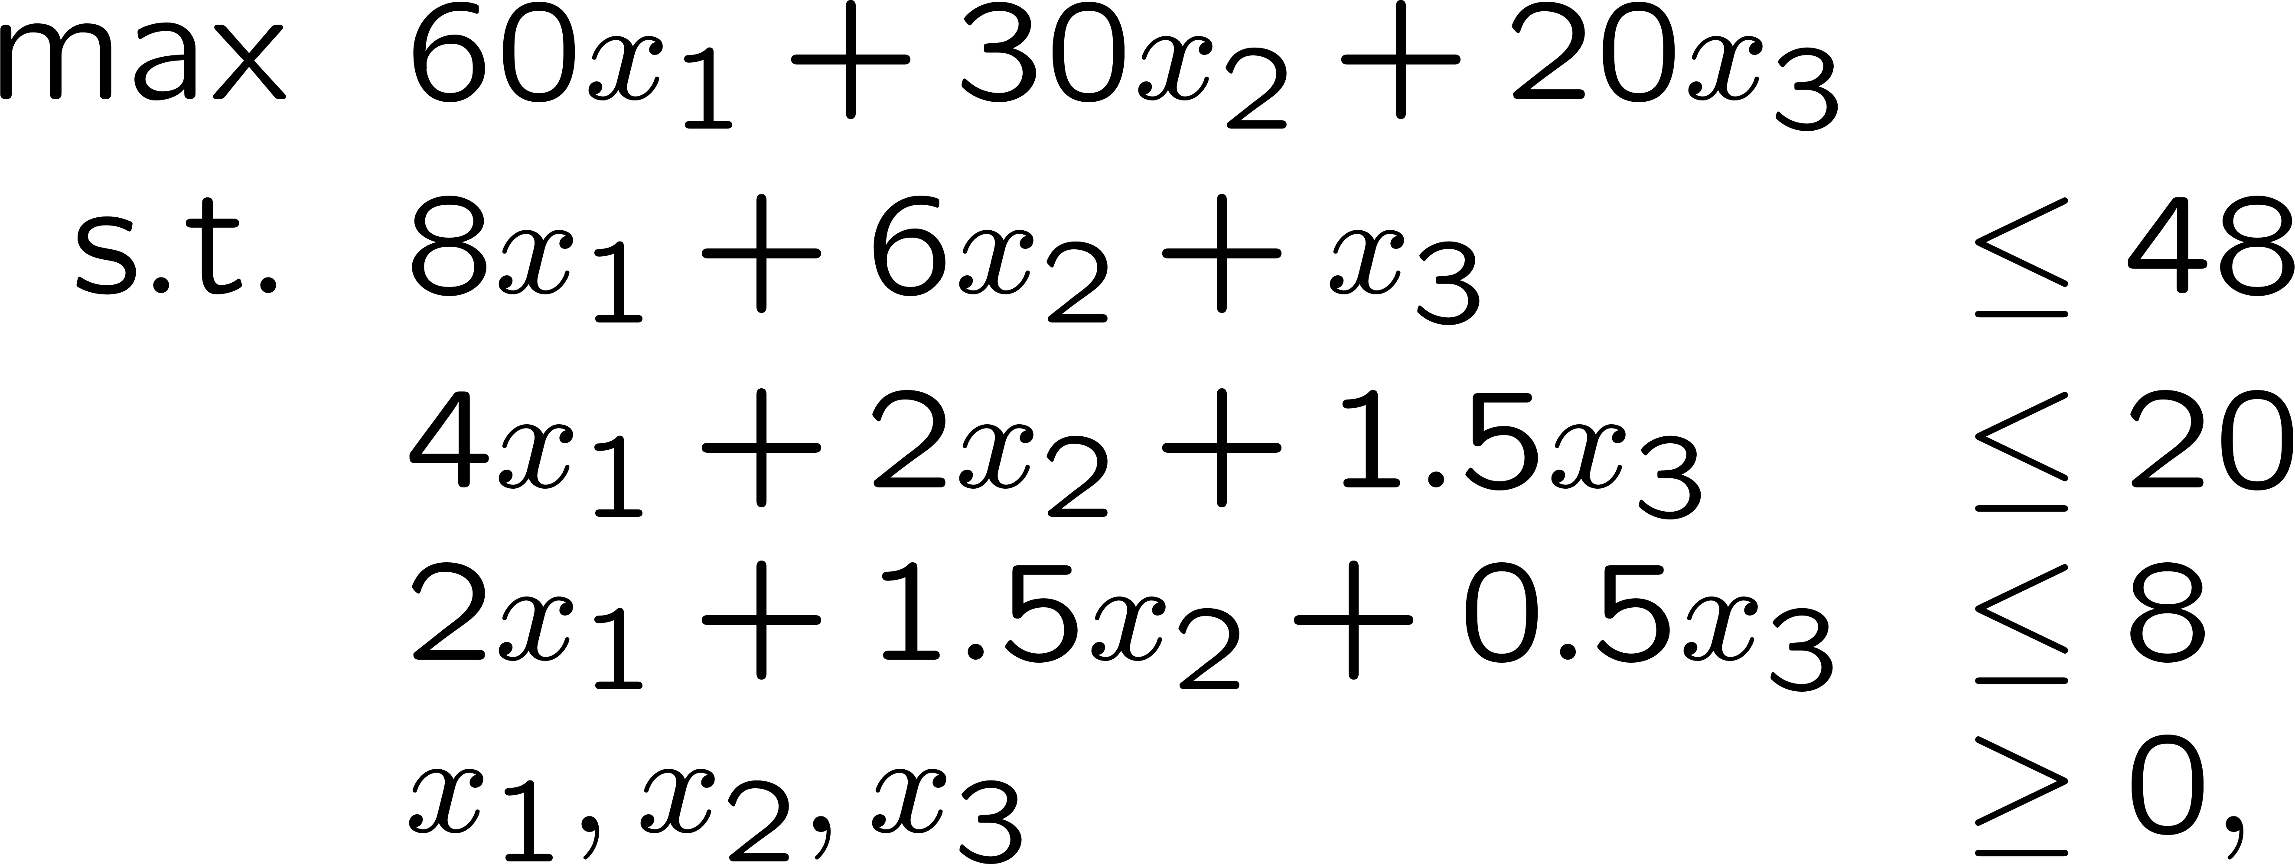
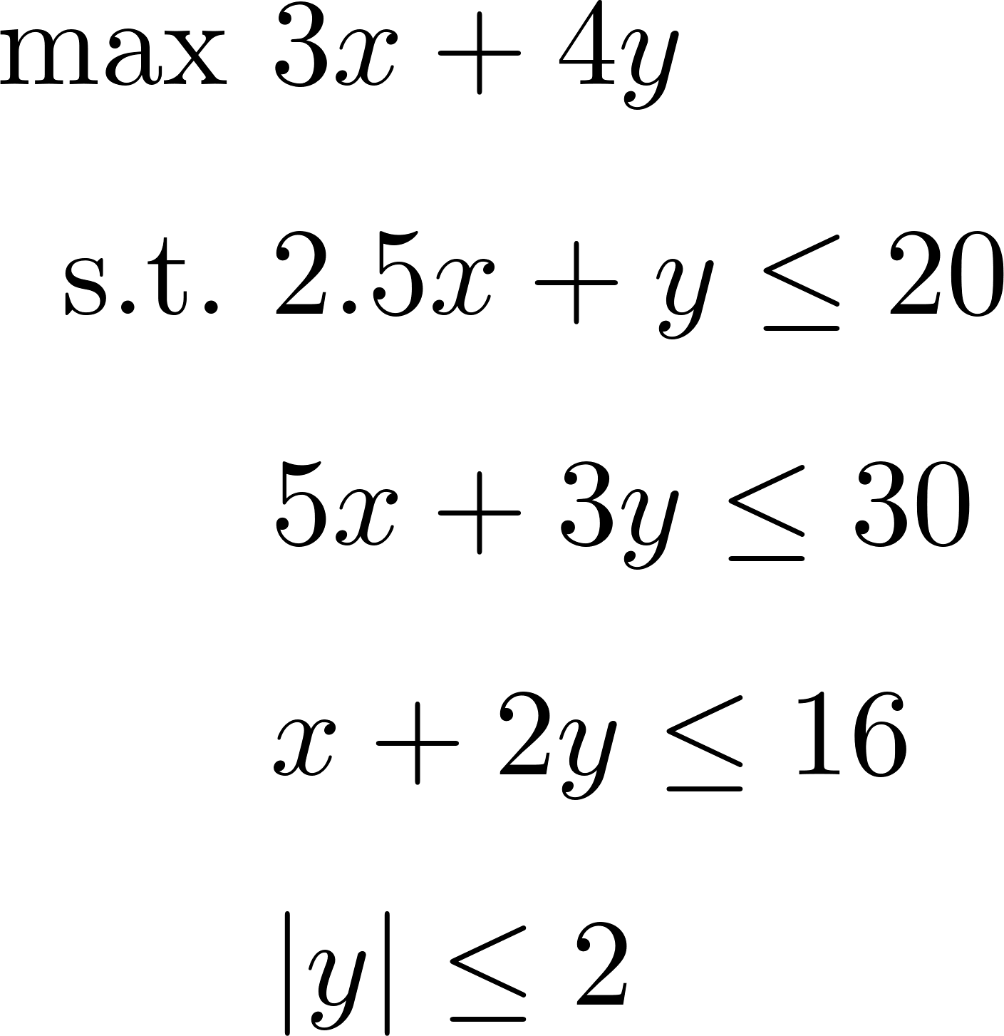
Exercises
Notes:
min 48 p1 + 20 p2 + 8 p3
s.t. 8 p1 + 4 p2 + 2 p3 >= 60
6 p1 + 2 p2 + 1.5 p3 >= 30
p1 + 1.5 p2 + 0.5 p3 >= 20
p1, p2, p3 >= 0
For the second model, we first need to reformulate it to a LOP, i.e., |y| <= 2 to y <= 2, y >= -2
The sign of x is not specified, so it is free.
The two constraints (y <= 2, y >= -2) implies that y is also free.
min 20 p1 + 30 p2 + 16 p3 + 2 p4 – 2 p5
s.t. 2.5 p1 + 5 p2 + p3 + 0 p4 + 0 p5 = 3
p1 + 3 p2 + 2p3 + p4 + p5 = 4

Slide 39
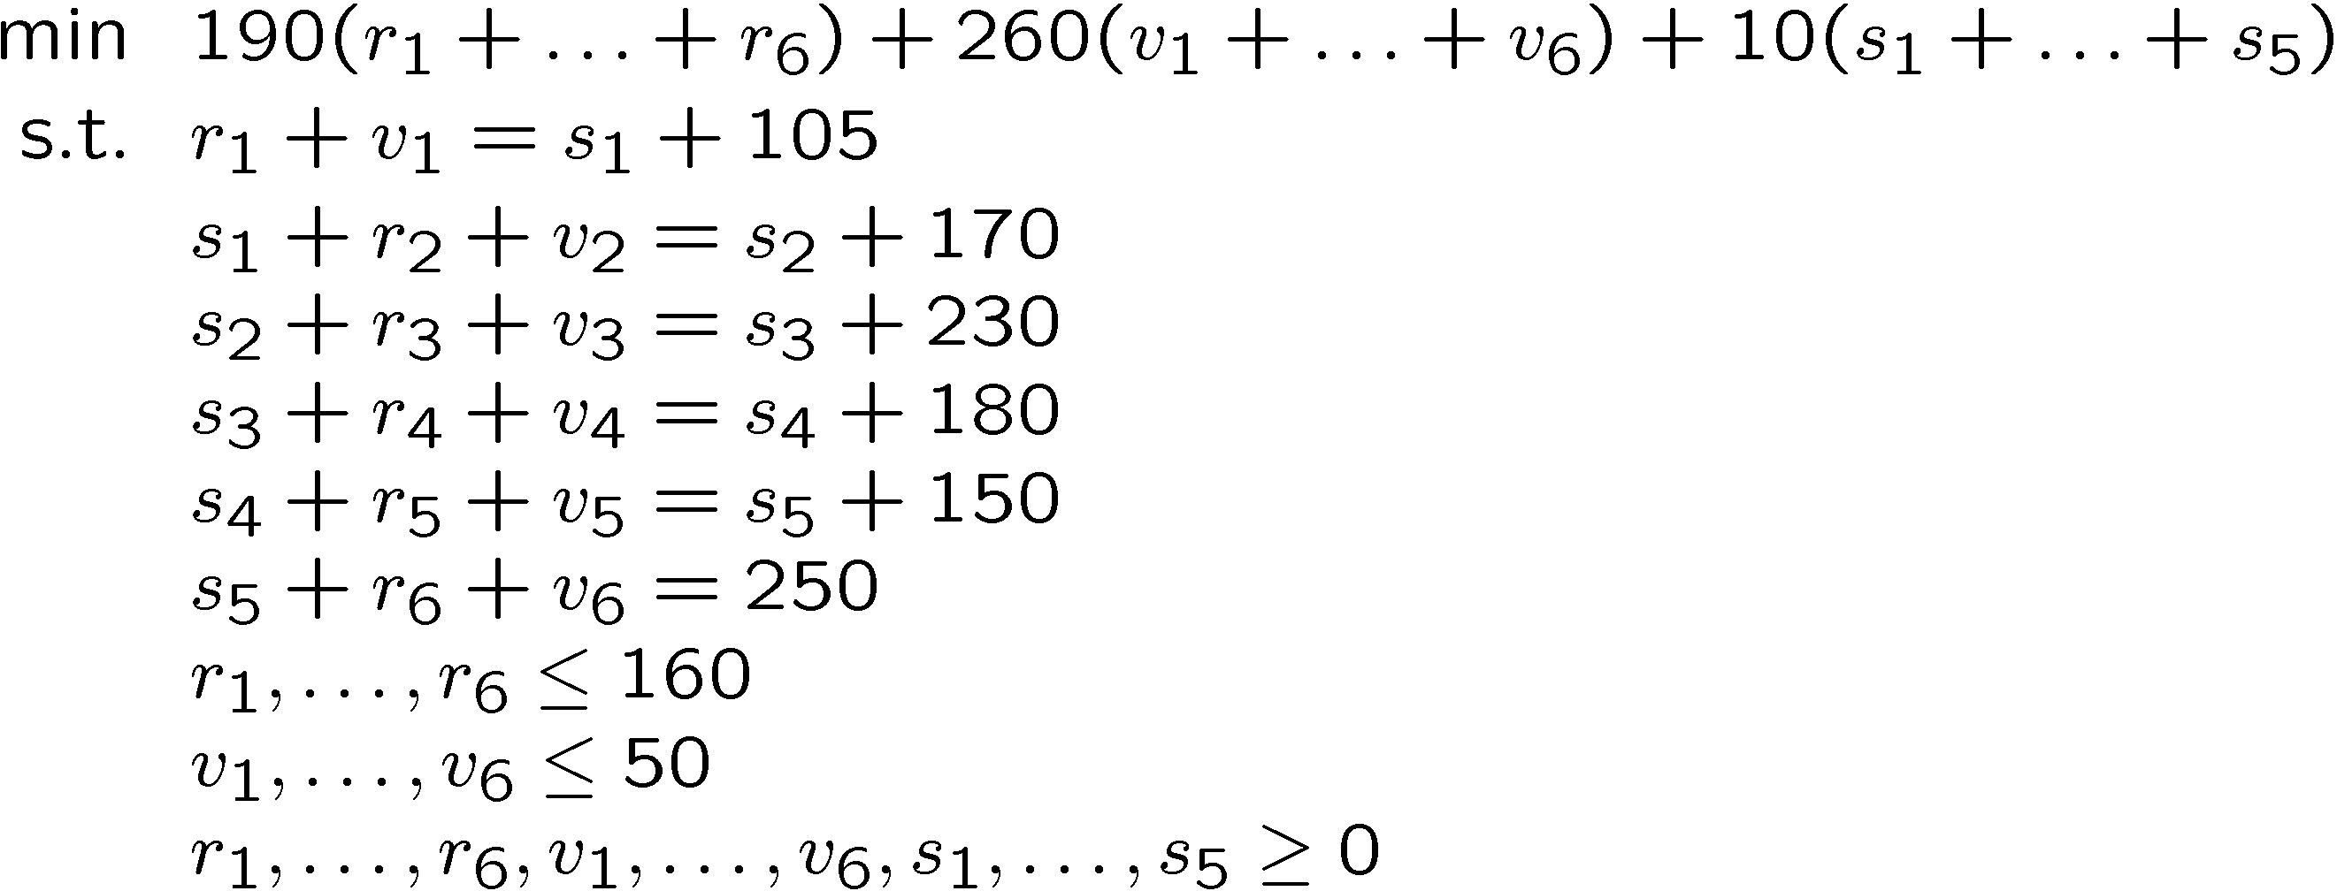
Exercises
Notes:
Can you try this one?

Slide 40
Exercises
Notes:
Can you try this one?

Slide 41
Assessing Dual Model in RSOME
The dual model can be assessed via method do_math()
primal = model.do_math() # standard form of the primal problem
dual = model.do_math(primal = False) # standard form of the dual problem
primal.show()
Dual.show()

